Slide 1
WHAM runs to-date

Slide 2
Bridge runs
Run 1: MT 2021 but turn off all indices but NEFSC spring BTS and Rec CPA (Tim showed this a few weeks ago)
Run 2: Update fishing fleets from trawl/nontrawl to commercial/recreational
Run 3: Update NEFSC Spring BTS and Rec CPA with new time series

Slide 3
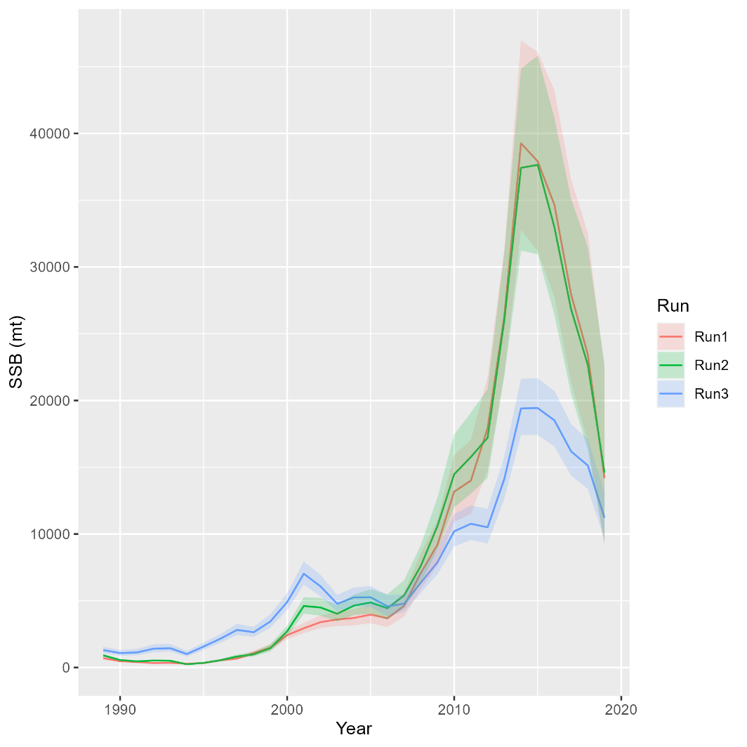
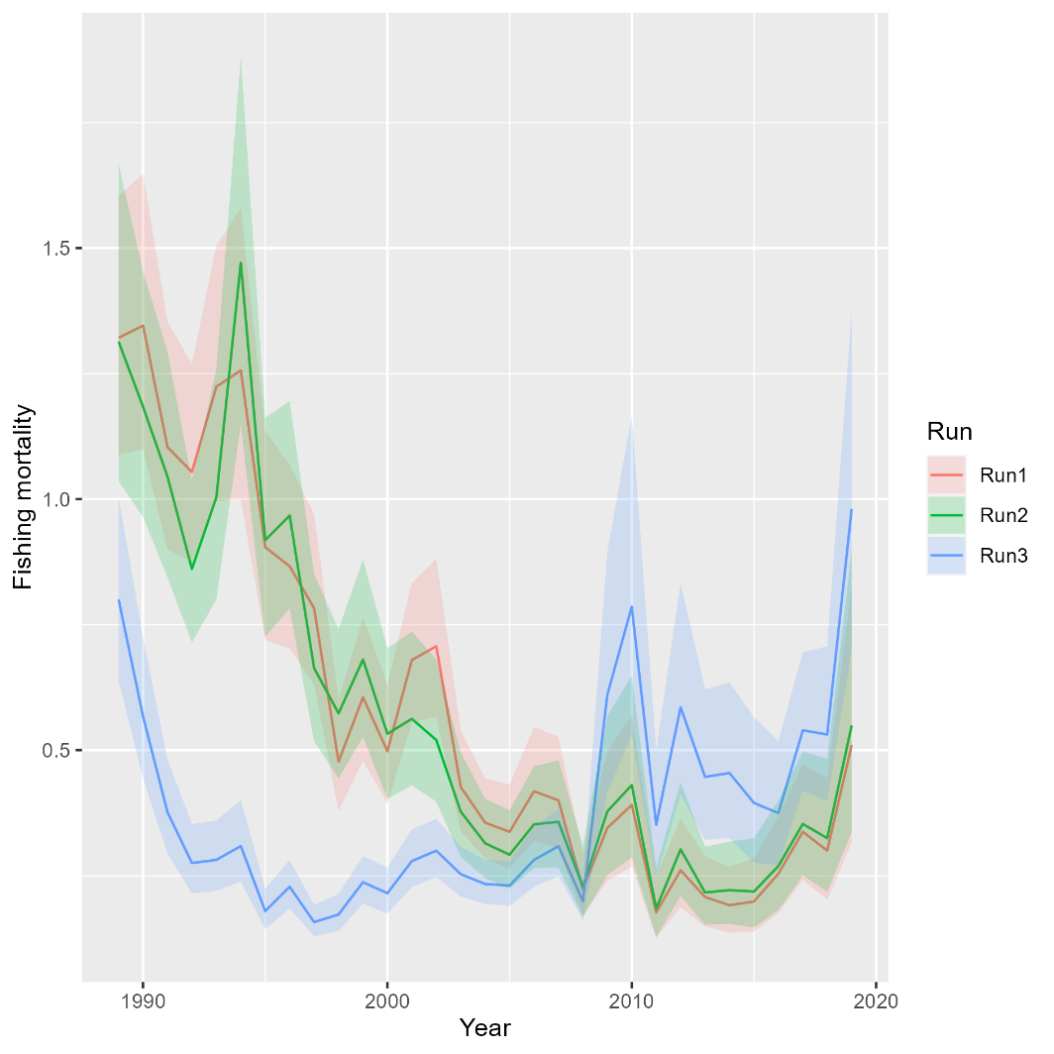
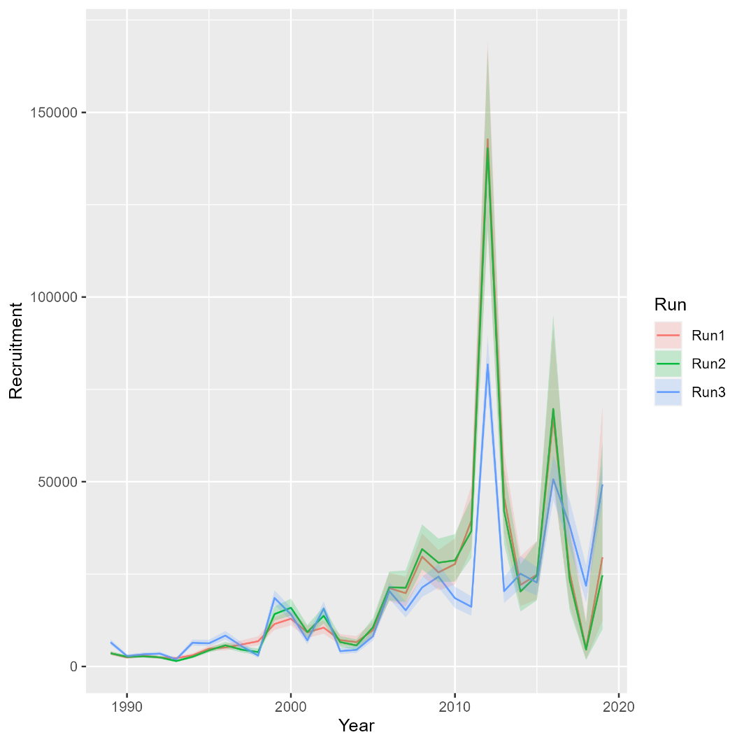
Runs 1-3: updating fishing fleets, NEFSC BTS, Rec CPA
Mohn’s rho
Run | F | SSB | Rect
1 | 1.472 | -0.608 | -0.628
2 | 1.371 | -0.568 | -0.634
3 | 0.777 | -0.351 | -0.153
North

Slide 4
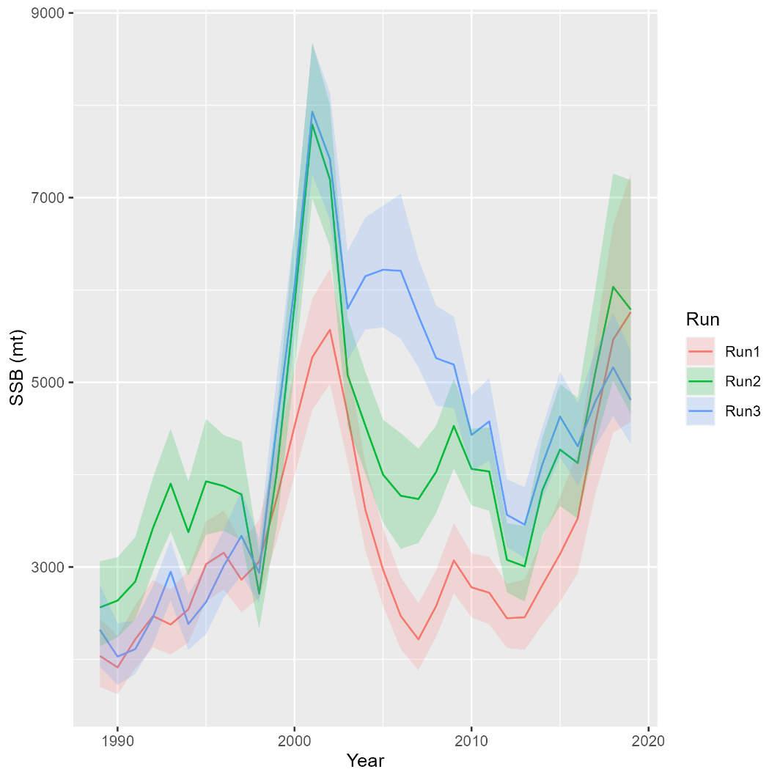
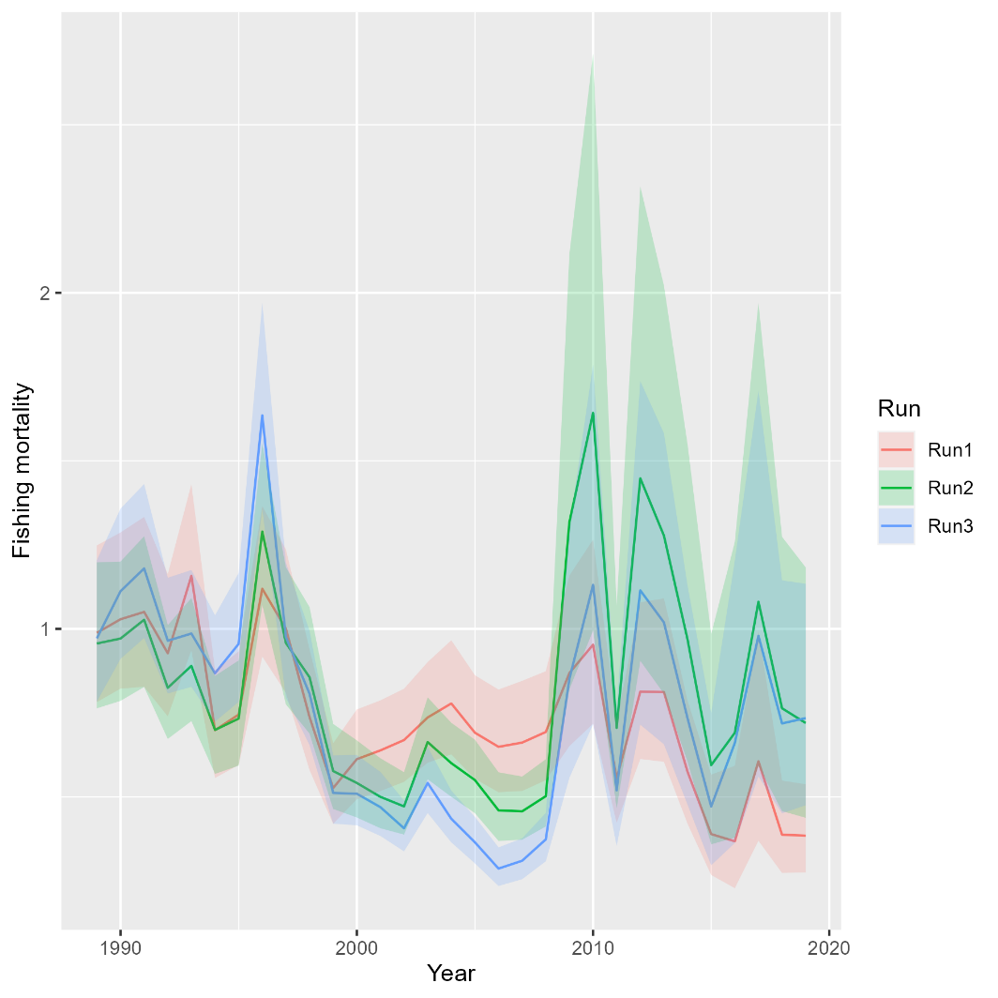
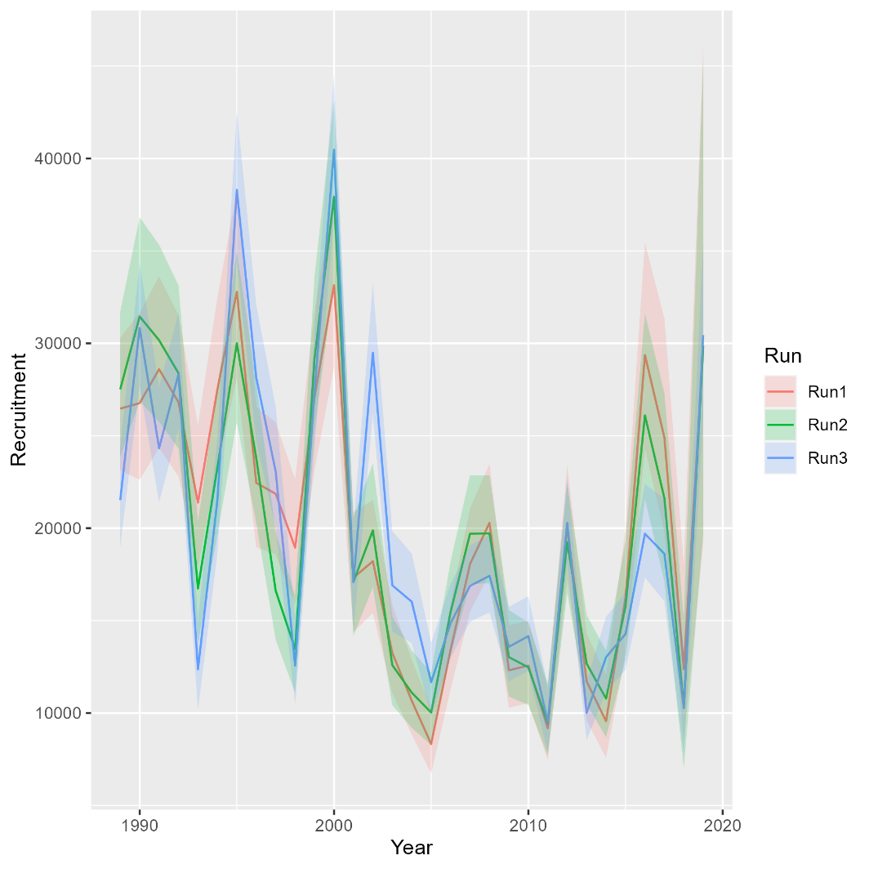
Runs 1-3: updating fishing fleets, NEFSC BTS, Rec CPA
Mohn’s rho
Run | F | SSB | Rect
1 | -0.147 | 0.166 | 0.389
2 | -0.002 | 0.057 | 0.161
3 | -0.087 | 0.074 | 0.05
South

Slide 5
Bridge runs
Run 1: MT 2021 but turn off all indices but NEFSC spring BTS and Rec CPA (Tim showed this a few weeks ago)
Run 2: Update fishing fleets from trawl/nontrawl to commercial/recreational
Run 3: Update NEFSC Spring BTS and Rec CPA with new time series
Run 4: Add 2020-2021 data

Slide 6
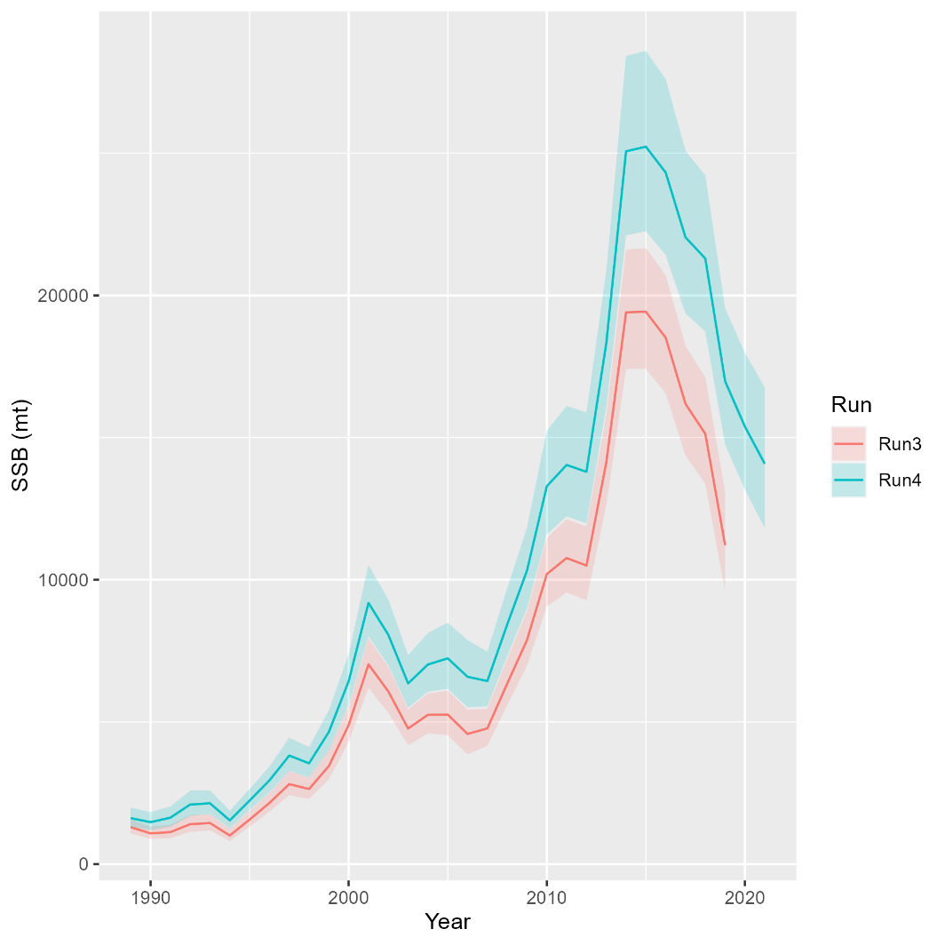
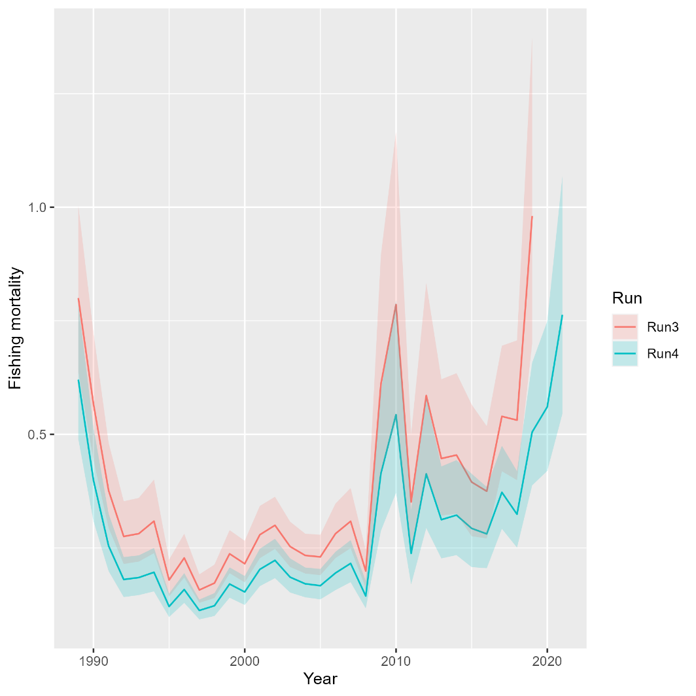
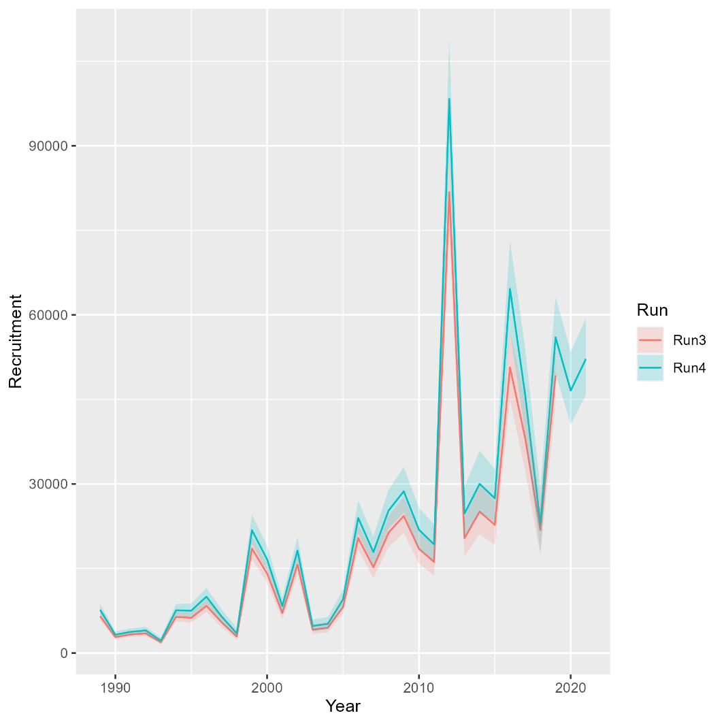
Runs 3-4: Adding 2020-2021
Mohn’s rho
Run | F | SSB | Rect
3 | 0.777 | -0.351 | -0.153
4 | 1.294 | -0.431 | -0.165
North

Slide 7
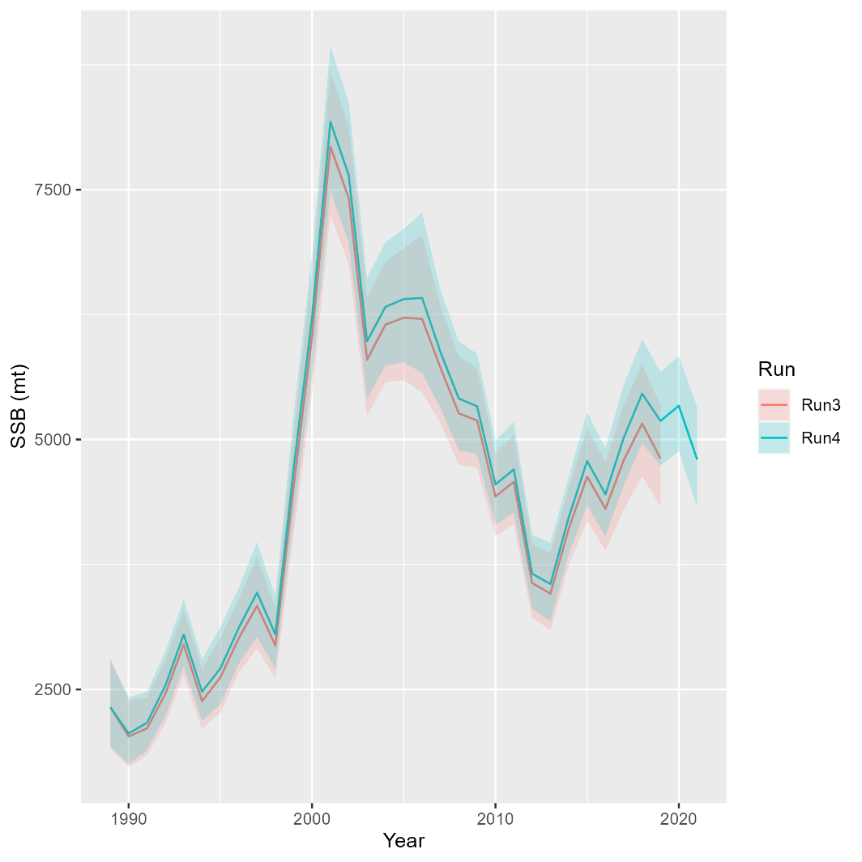
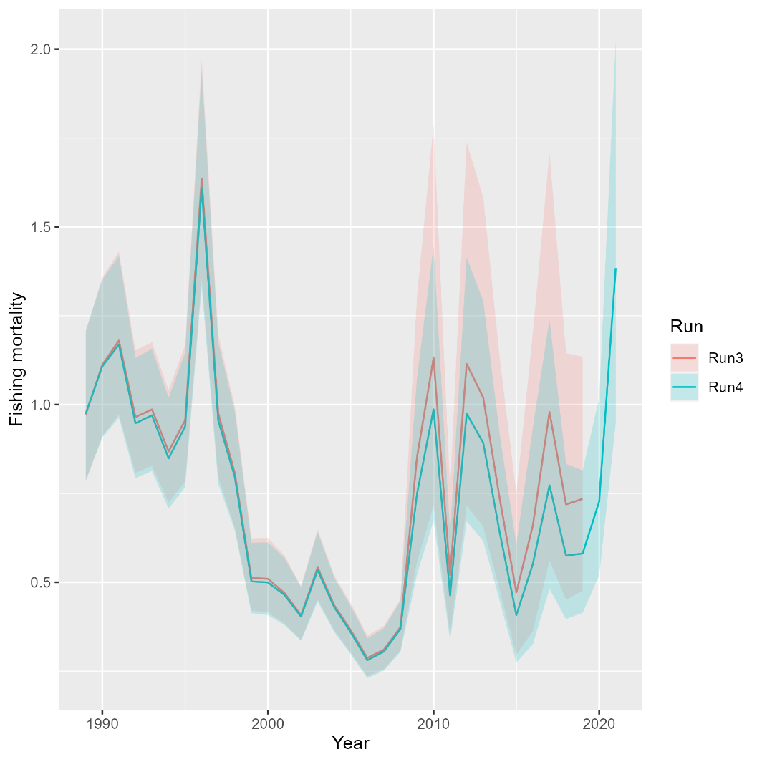
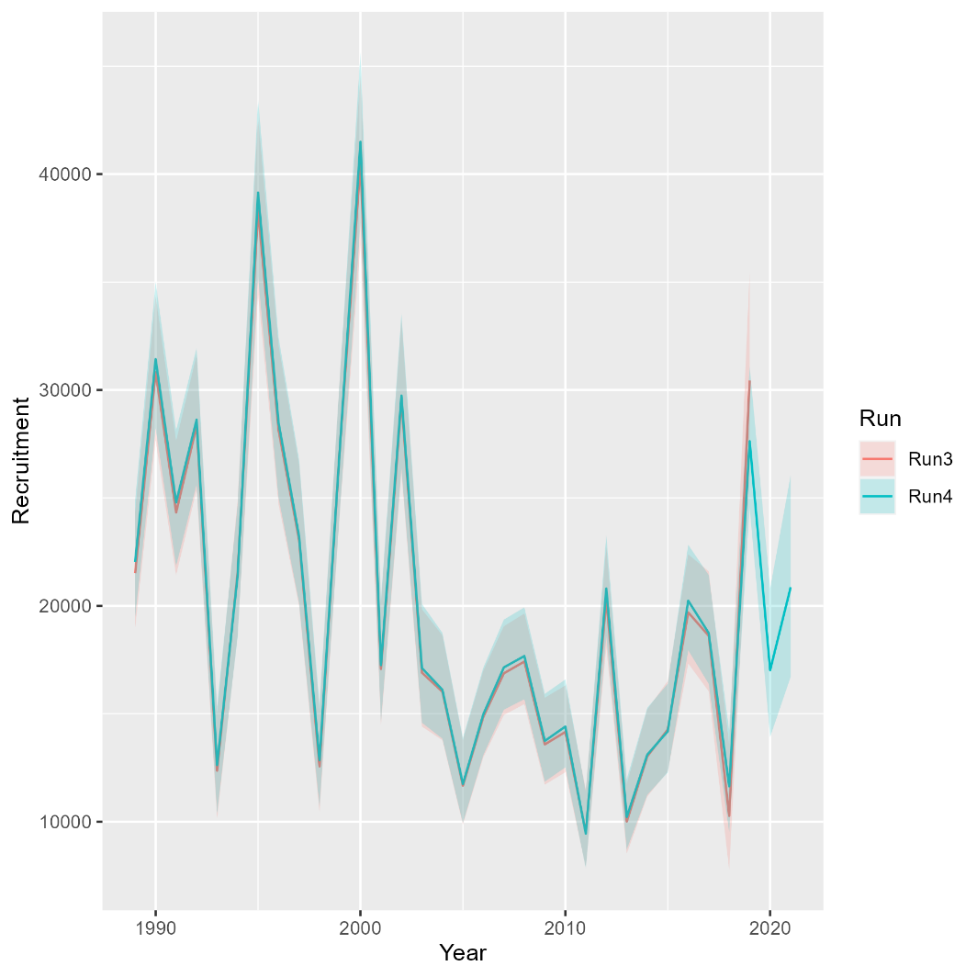
Runs 3-4: Adding 2020-2021
Mohn’s rho
Run | F | SSB | Rect
3 | -0.087 | 0.074 | 0.05
4 | 0.107 | -0.017 | 0.005
South

Slide 8
Bridge runs
Run 1: MT 2021 but turn off all indices but NEFSC spring BTS and Rec CPA (Tim showed this a few weeks ago)
Run 2: Update fishing fleets from trawl/nontrawl to commercial/recreational
Run 3: Update NEFSC Spring BTS and Rec CPA with new time series
Run 4: Add 2020-2021 data
Run 5: Update maturity time series
Run 6: Add updated NEAMAP Indices
Run 7: Add updated state indices

Slide 9
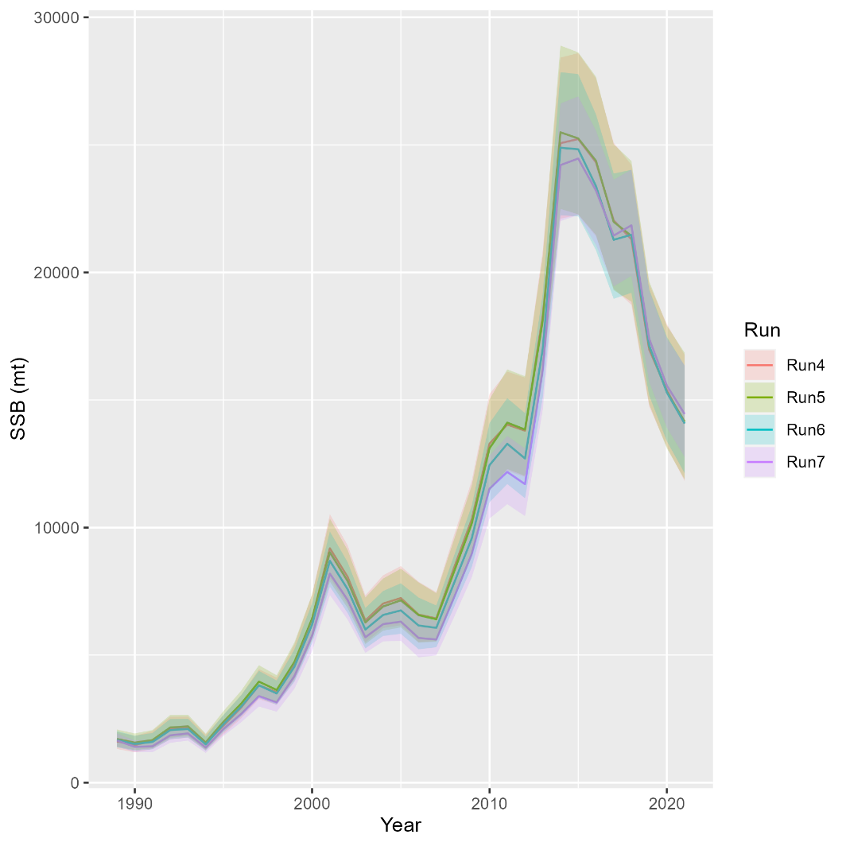
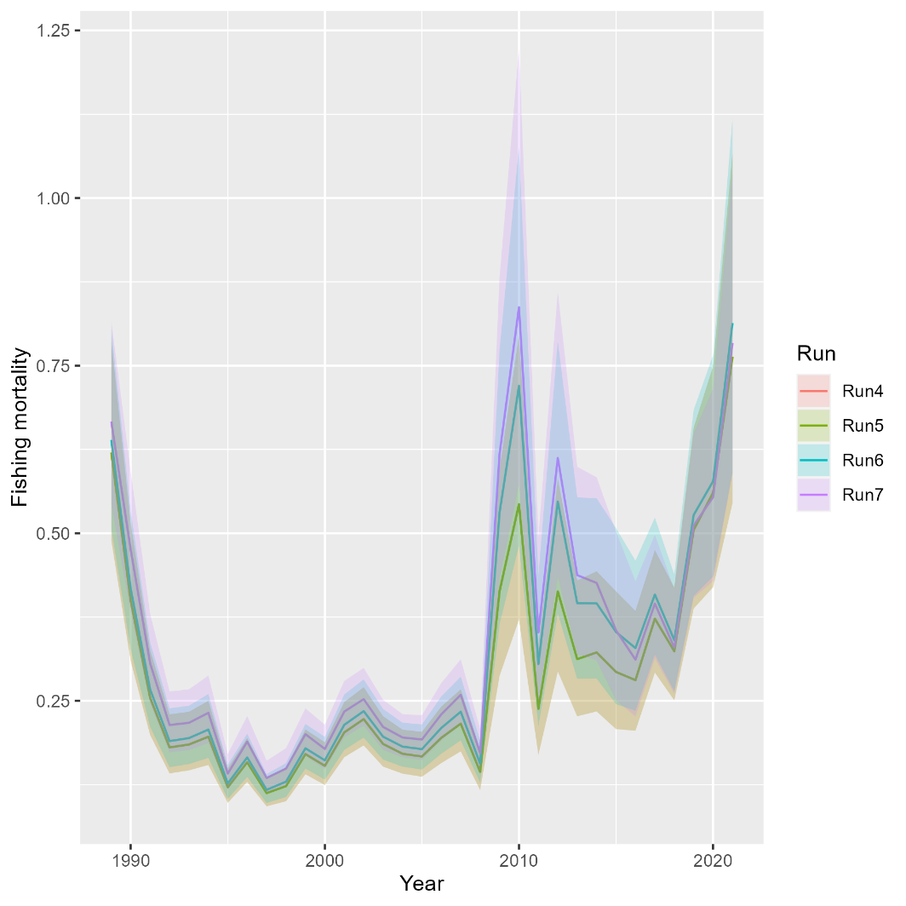
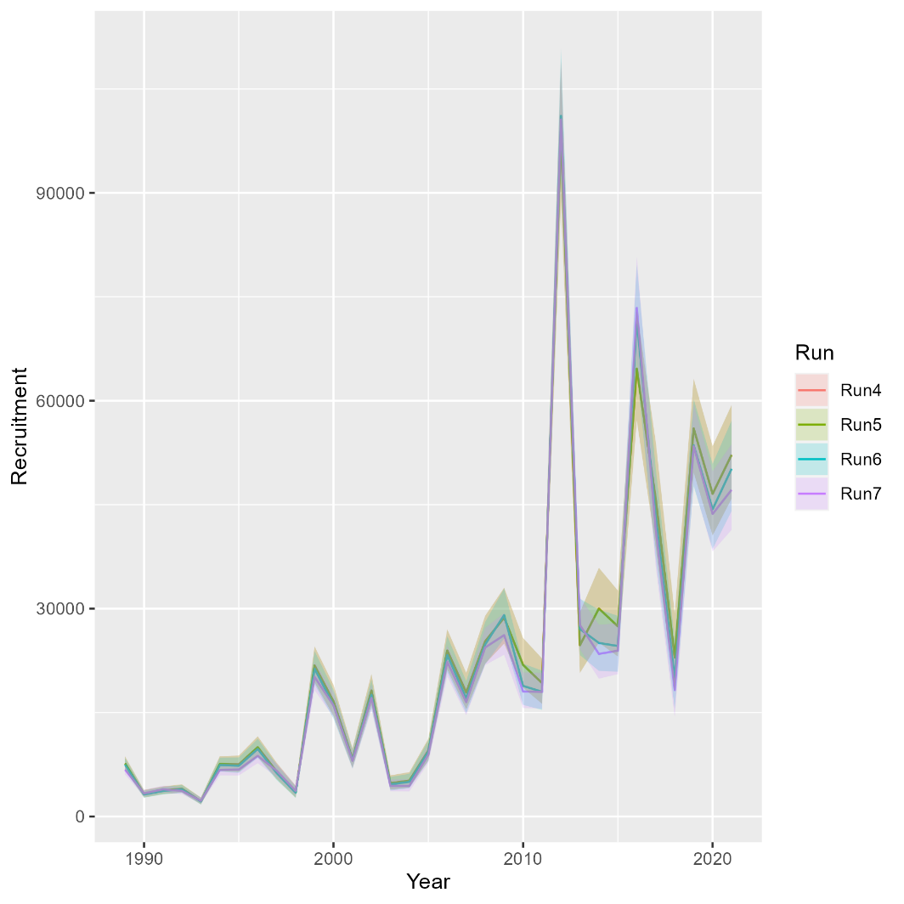
Runs 4-7: Adding maturity, NEAMAP, remaining state indices
Mohn’s rho
Run | F | SSB | Rect
4 | 1.294 | -0.431 | -0.165
5 | 1.294 | -0.431 | -0.165
6 | 1.232 | -0.444 | -0.129
7 | 0.986 | -0.388 | -0.125
North

Slide 10
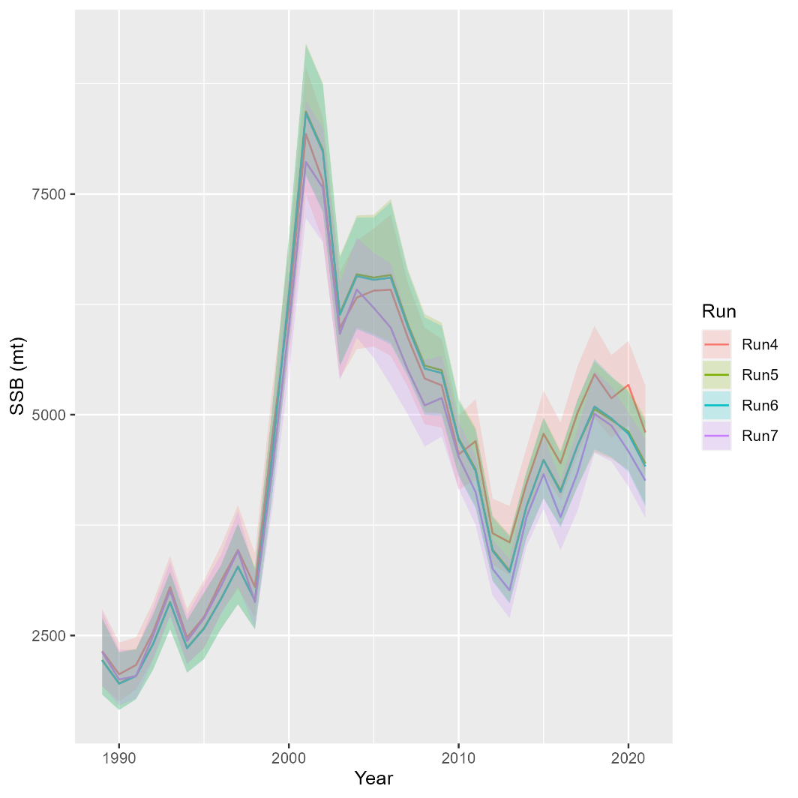
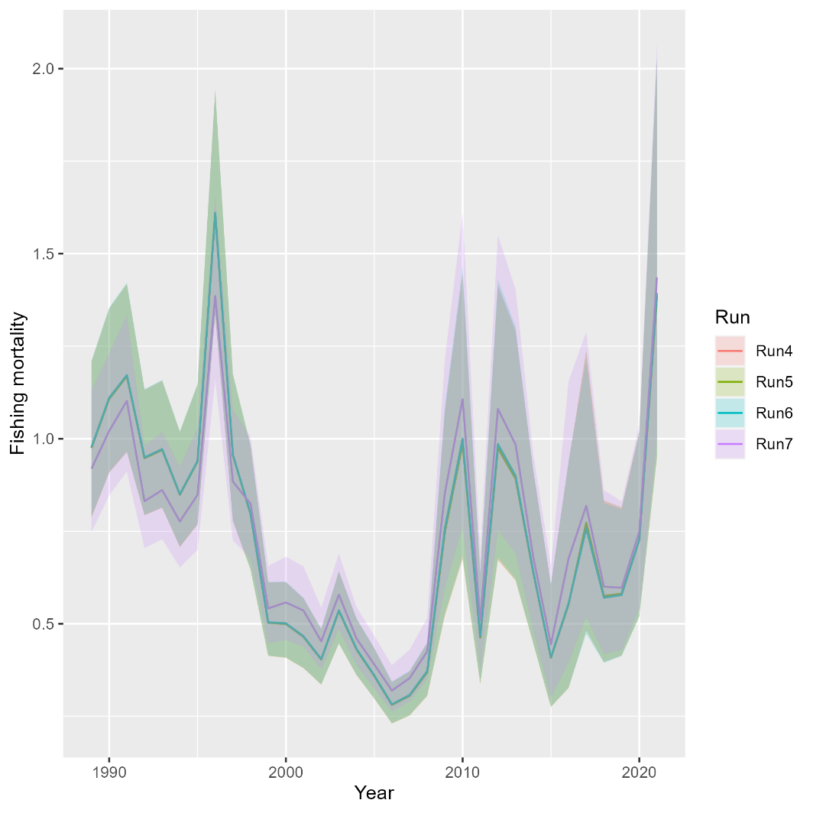
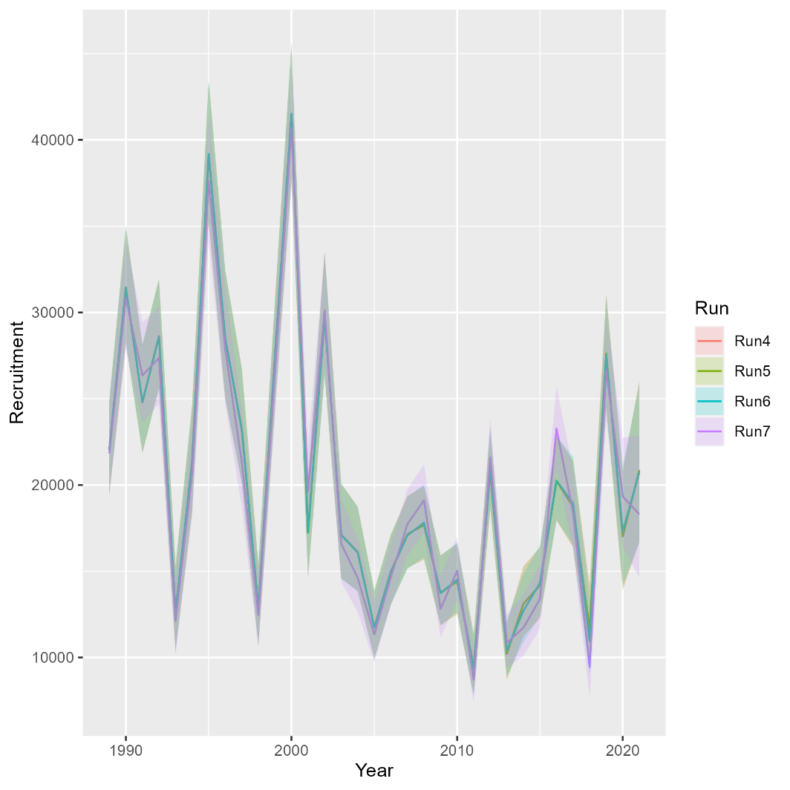
Runs 4-7: Adding maturity, NEAMAP, remaining state indices
Mohn’s rho
Run | F | SSB | Rect
4 | 0.107 | -0.017 | 0.005
5 | 0.107 | -0.015 | 0.005
6 | 0.106 | -0.013 | -0.029
7 | 0.121 | -0.012 | -0.061
South

Slide 11
VAST runs
Run 8: Spring and Fall VAST and RecCPA
Run 9: Spring VAST and RecCPA

Slide 12
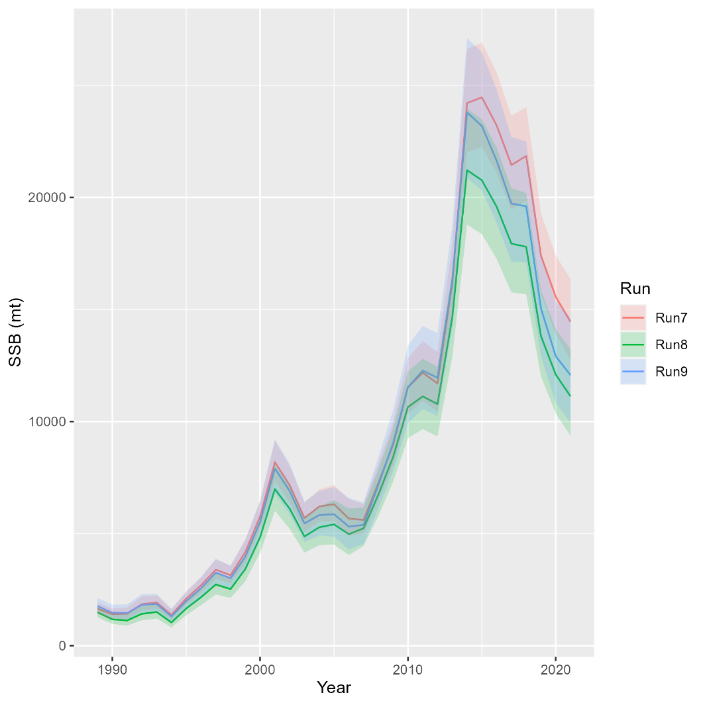
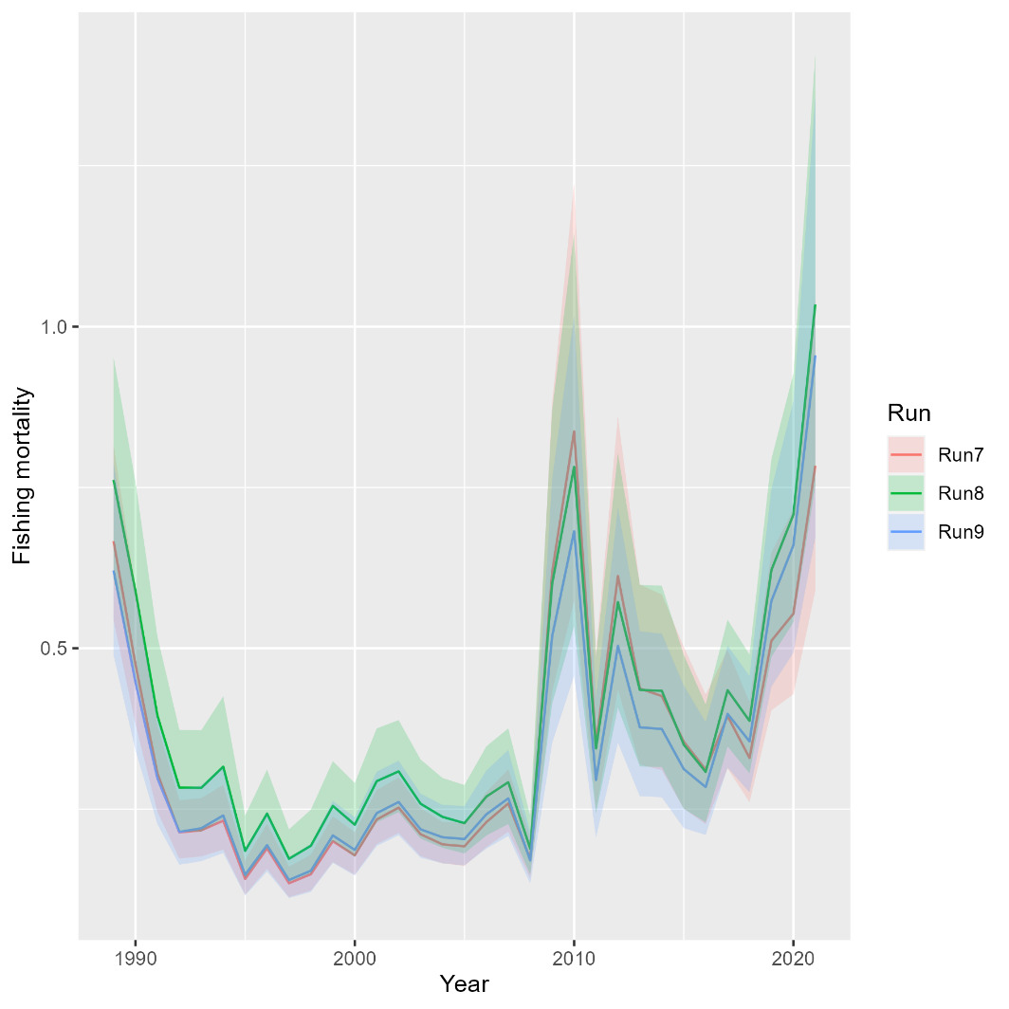
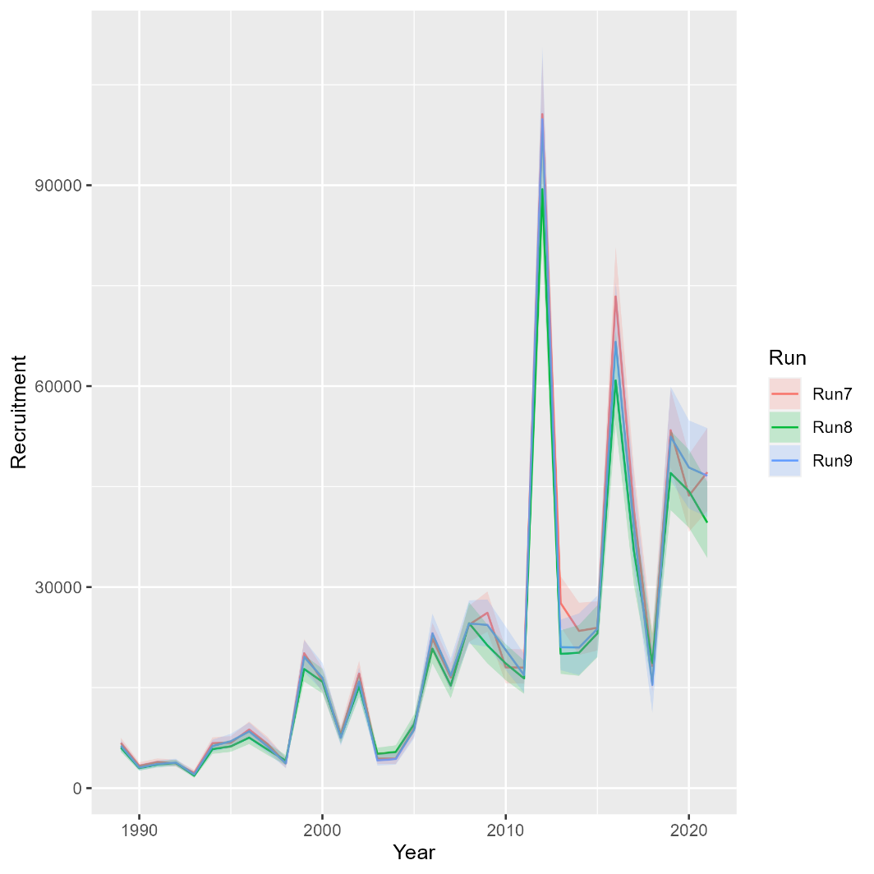
Runs 8-9: Exploring VAST
Mohn’s rho
Run | F | SSB | Rect
7 | 0.986 | -0.388 | -0.125
8 | 1.411 | -0.434 | -0.114
9 | 1.446 | -0.449 | -0.078
North

Slide 13
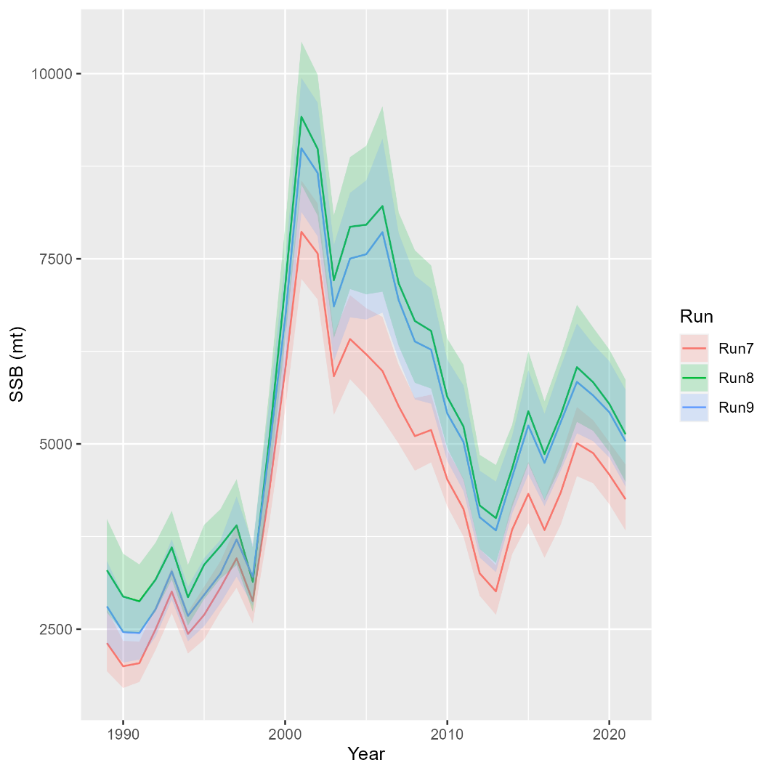
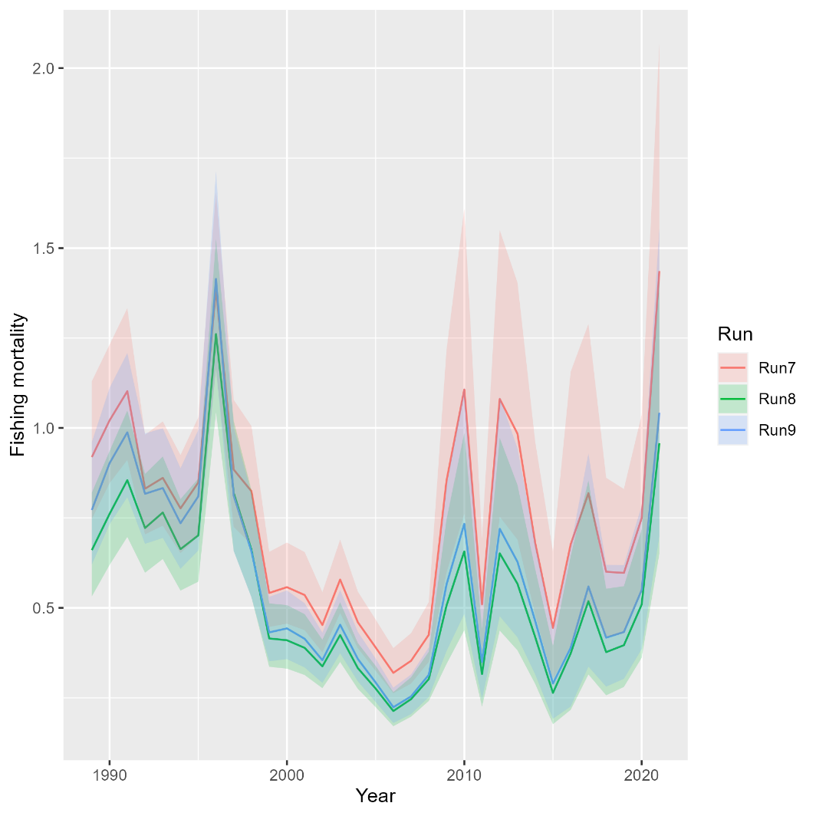
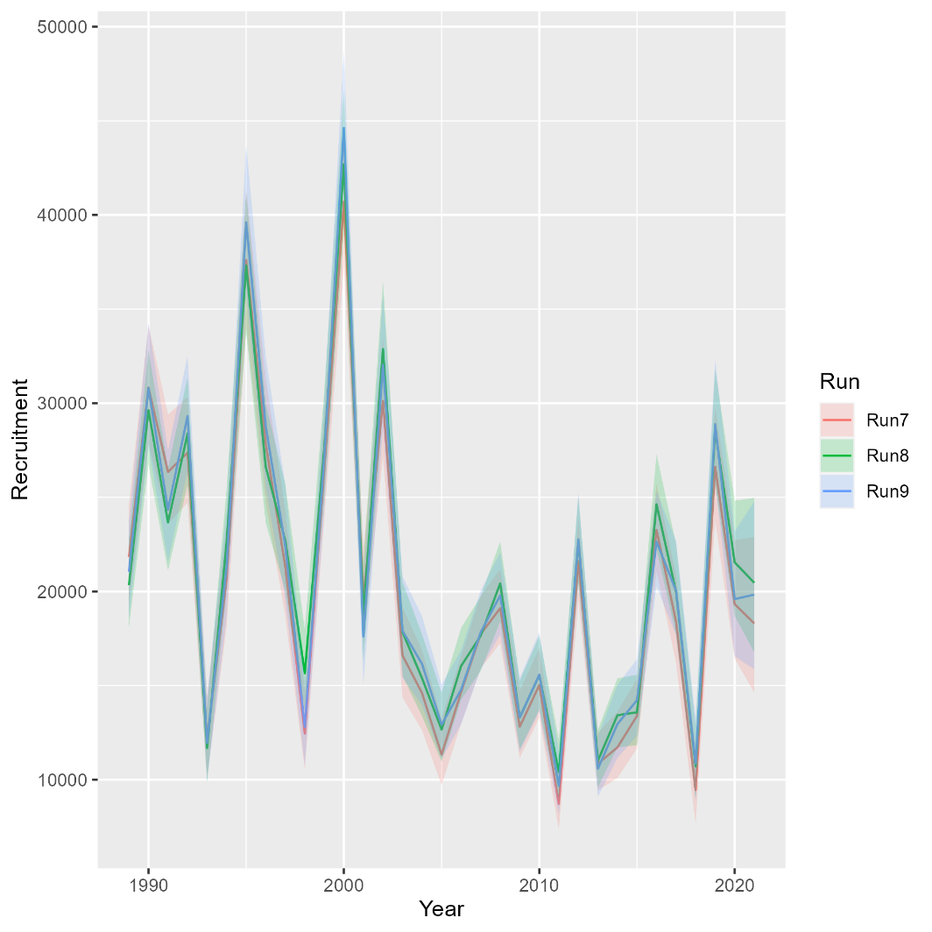
Runs 8-9: Exploring VAST
Mohn’s rho
Run | F | SSB | Rect
7 | 0.121 | -0.012 | -0.061
8 | 0.089 | -0.017 | 0.025
9 | 0.088 | -0.013 | -0.005
South

Slide 14
Rec CPA Selectivity
Run 10: Linked Rec CPA selectivity to recreational fishing fleet
**Need to relax this assumption in future iterations

Slide 15
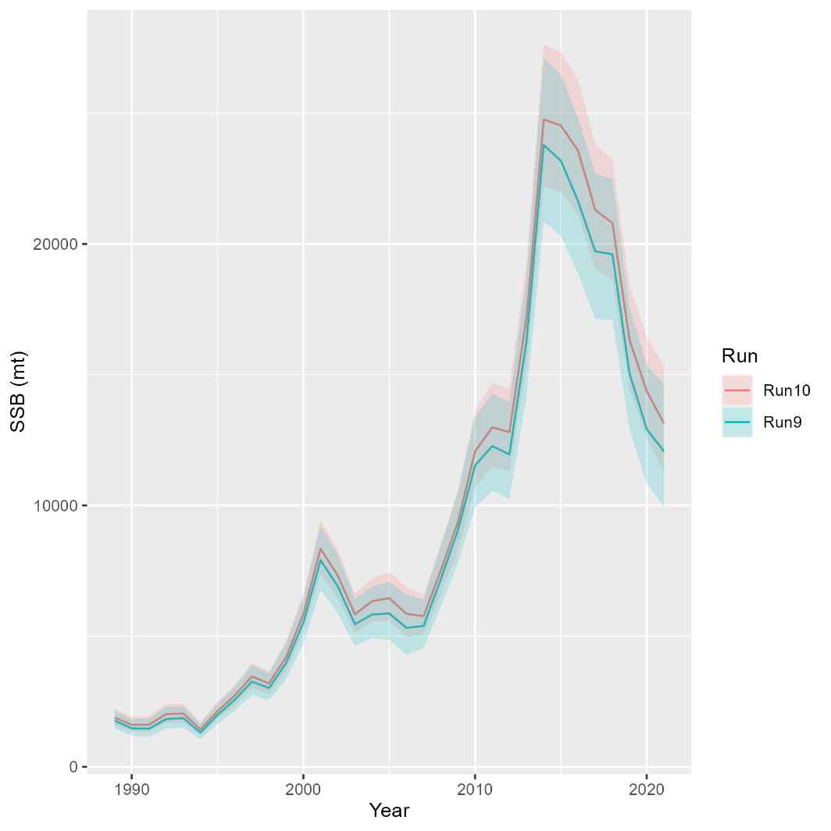
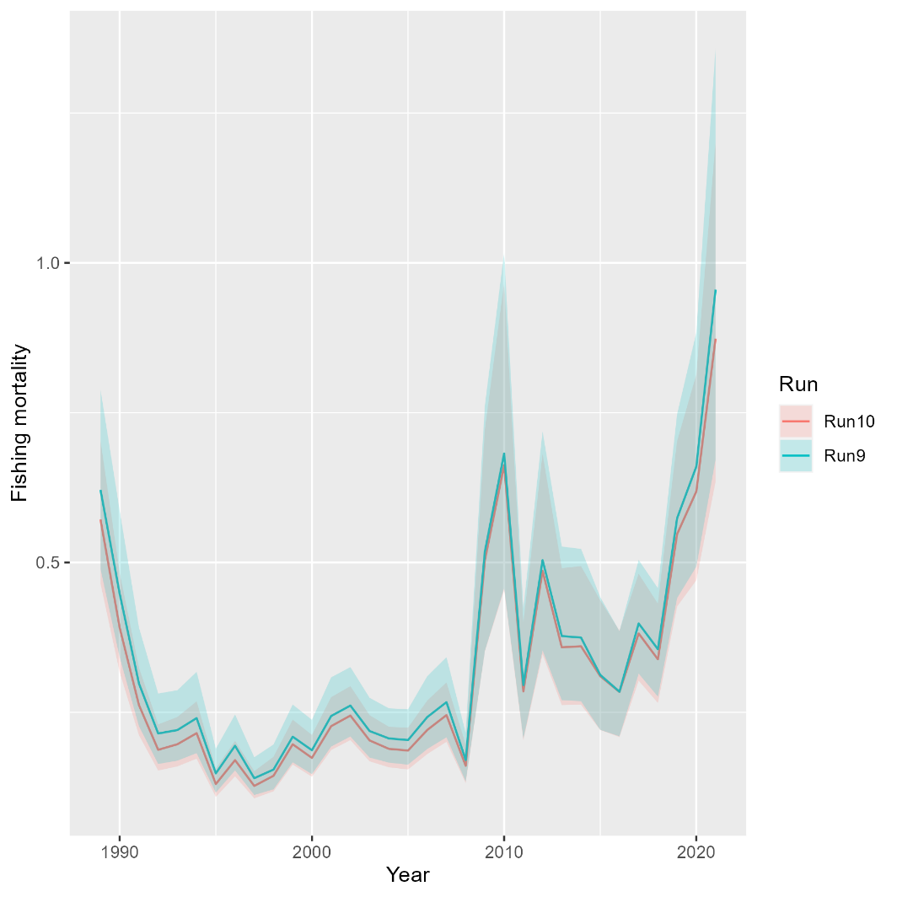
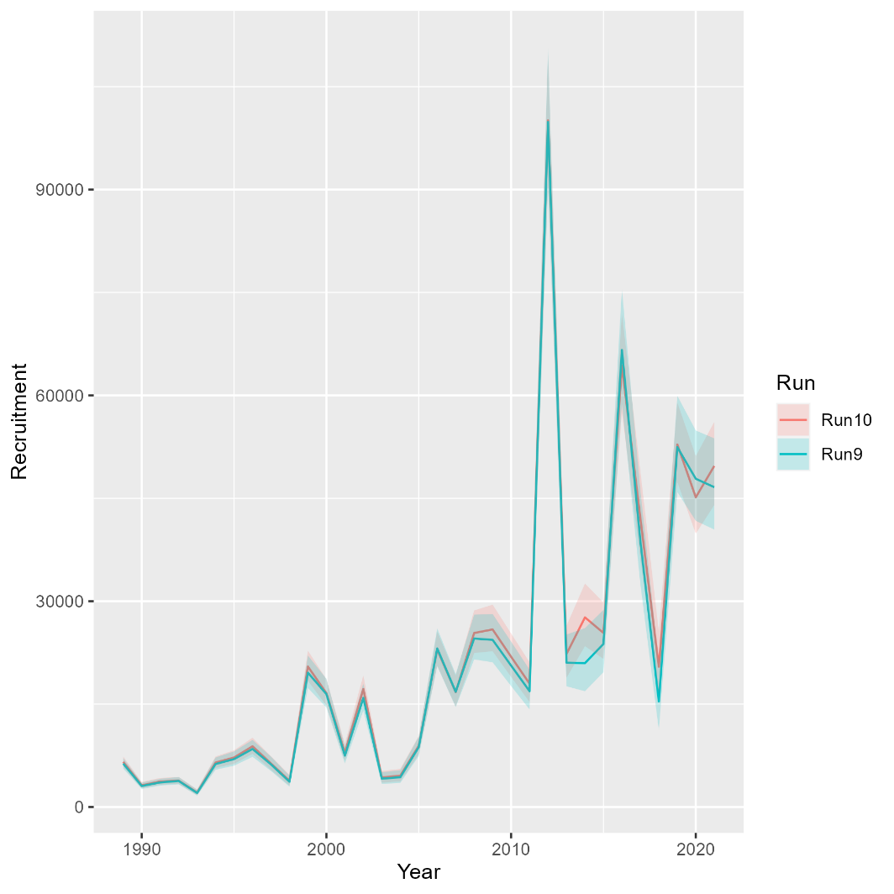
Runs 10: Rec CPA selectivity
Mohn’s rho
Run | F | SSB | Rect
9 | 1.446 | -0.449 | -0.078
10 | 1.235 | -0.408 | -0.122
North

Slide 16
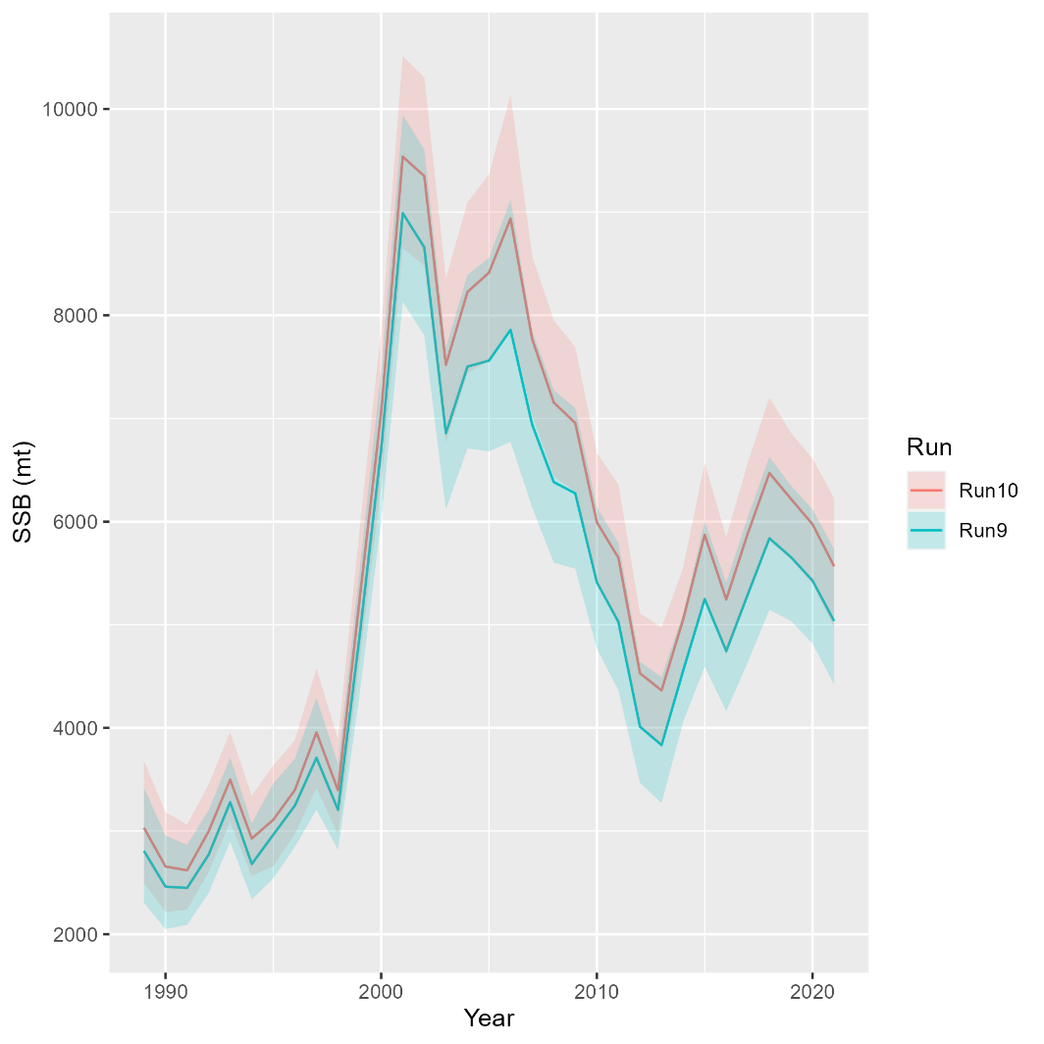
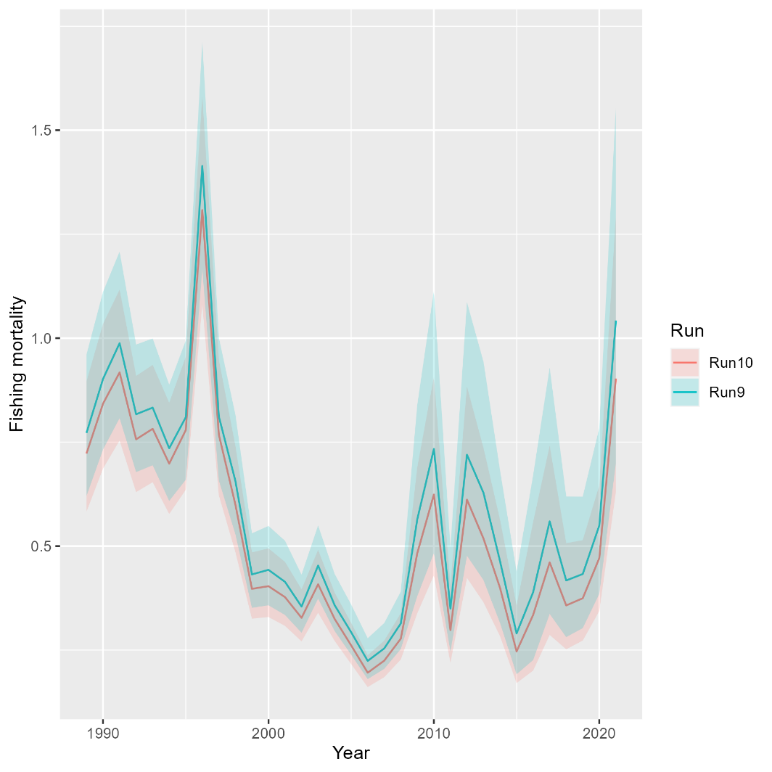
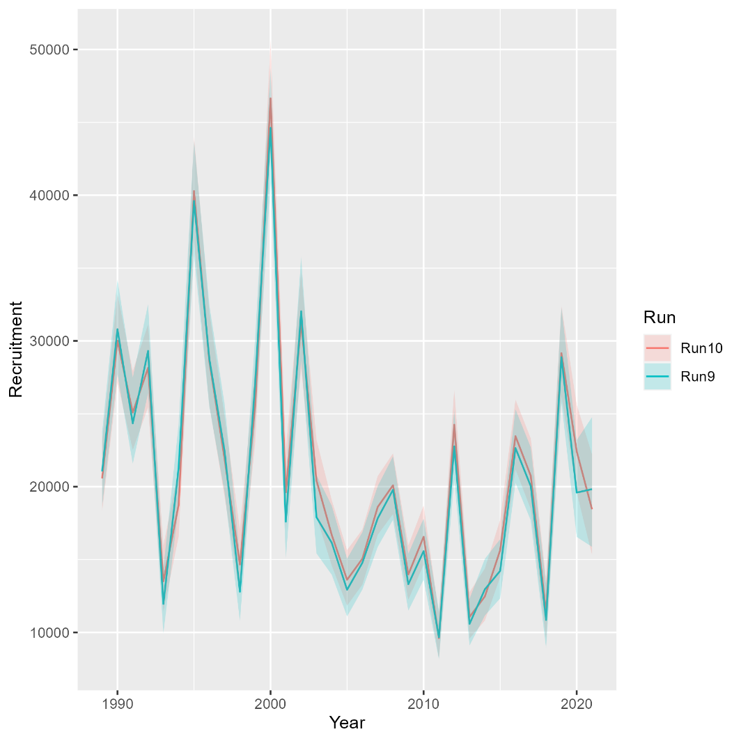
Runs 10: Rec CPA selectivity
Mohn’s rho
Run | F | SSB | Rect
9 | 0.088 | -0.013 | -0.005
10 | 0.106 | -0.032 | -0.04
South

Slide 17
Random effects
Run 11: Random effects (iid) for recruitment and survival

Slide 18
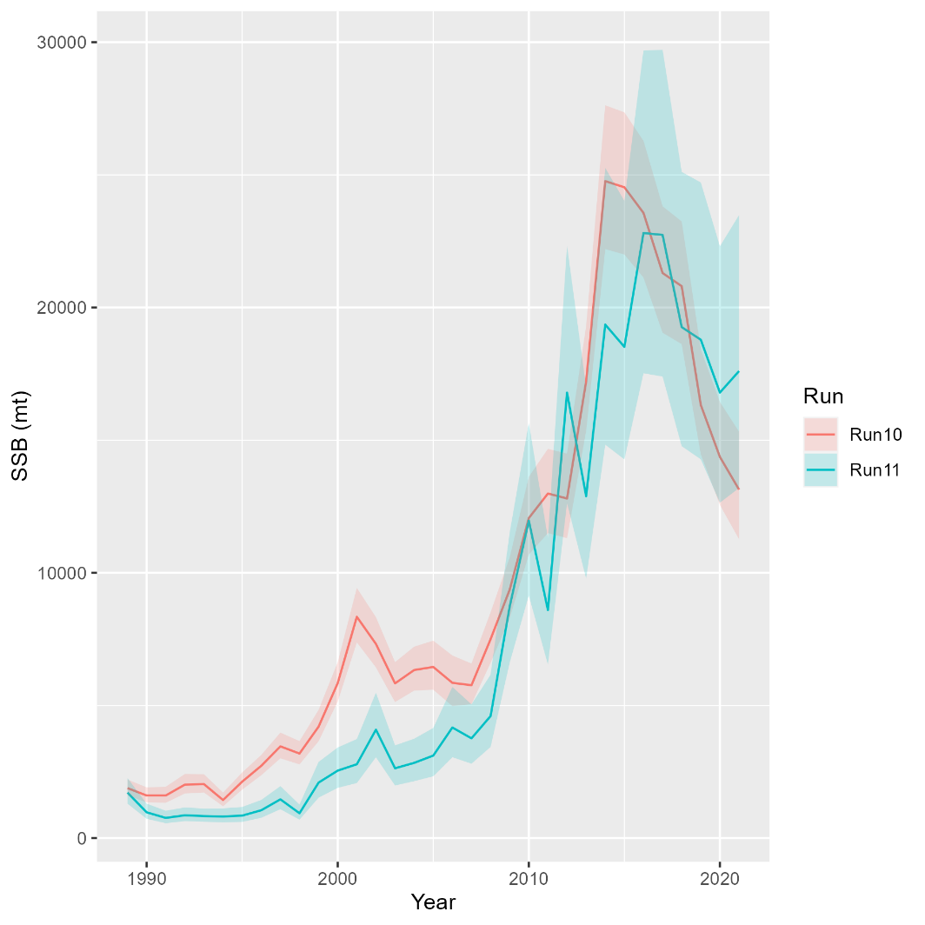
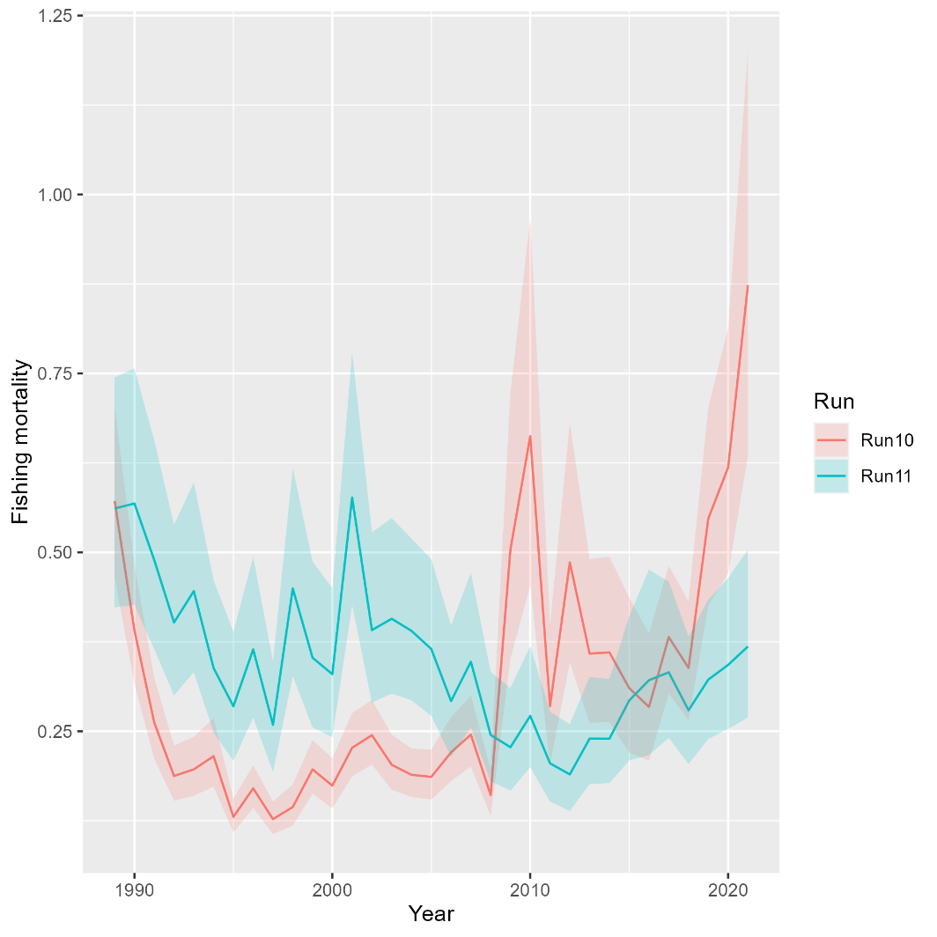
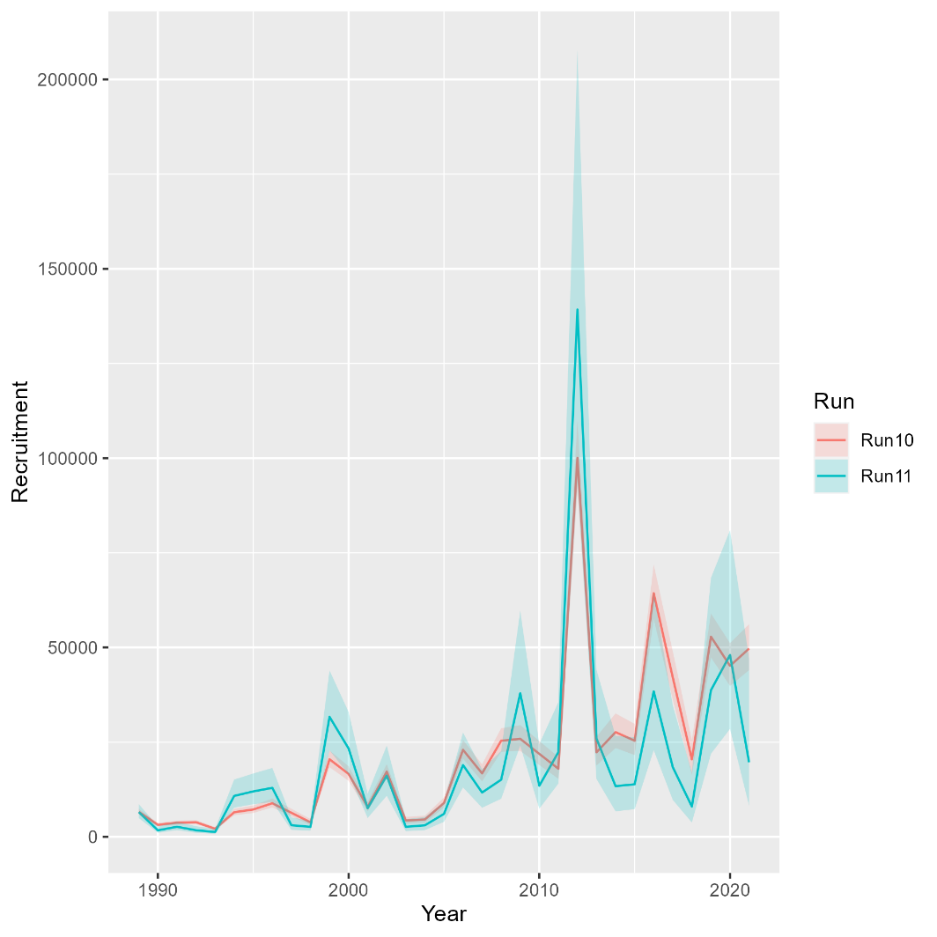
Runs 11: Random effects
Mohn’s rho
Run | F | SSB | Rect
10 | 1.235 | -0.408 | -0.122
11 | 0.144 | -0.128 | -0.188
North

Slide 19
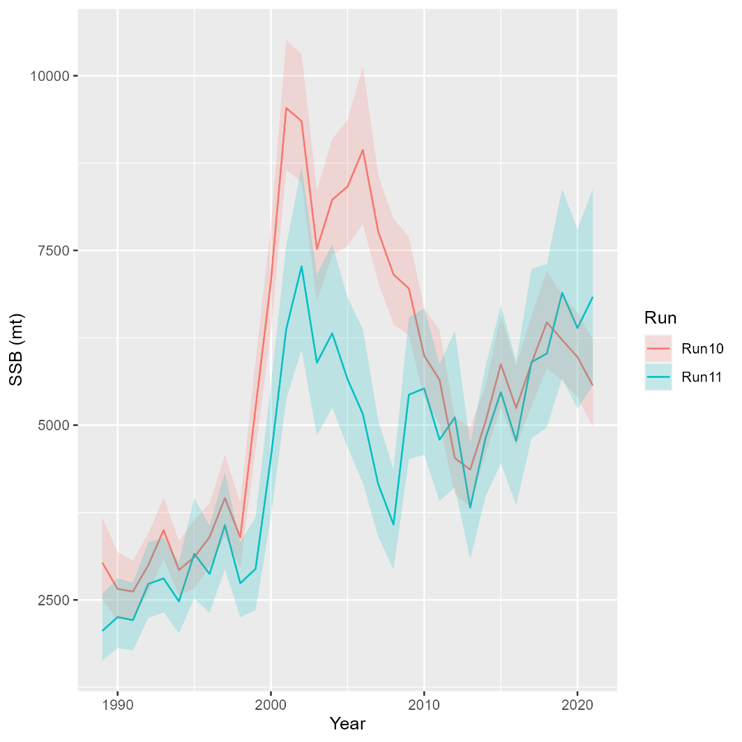
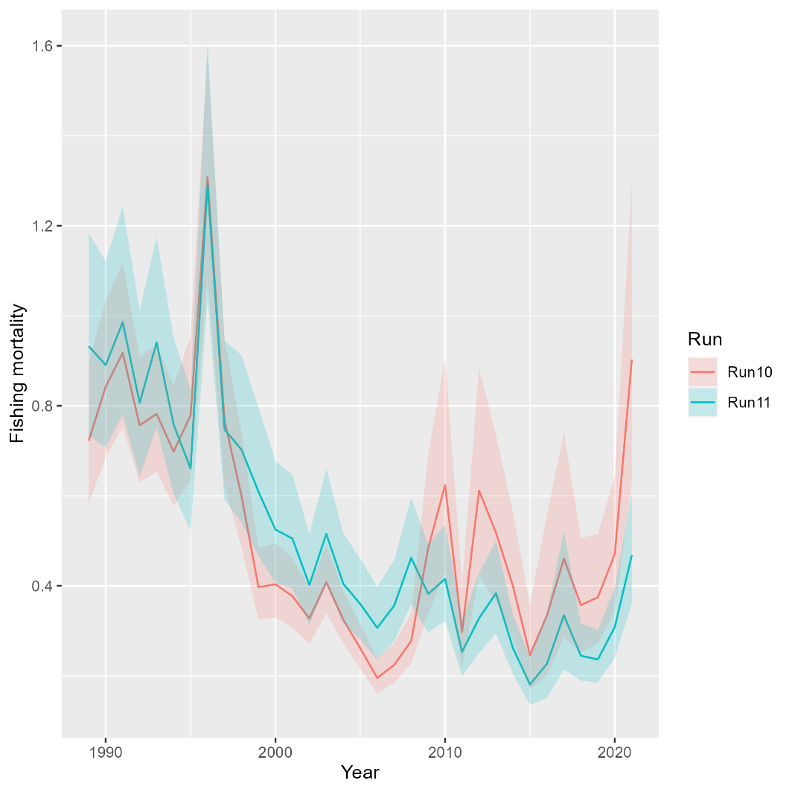
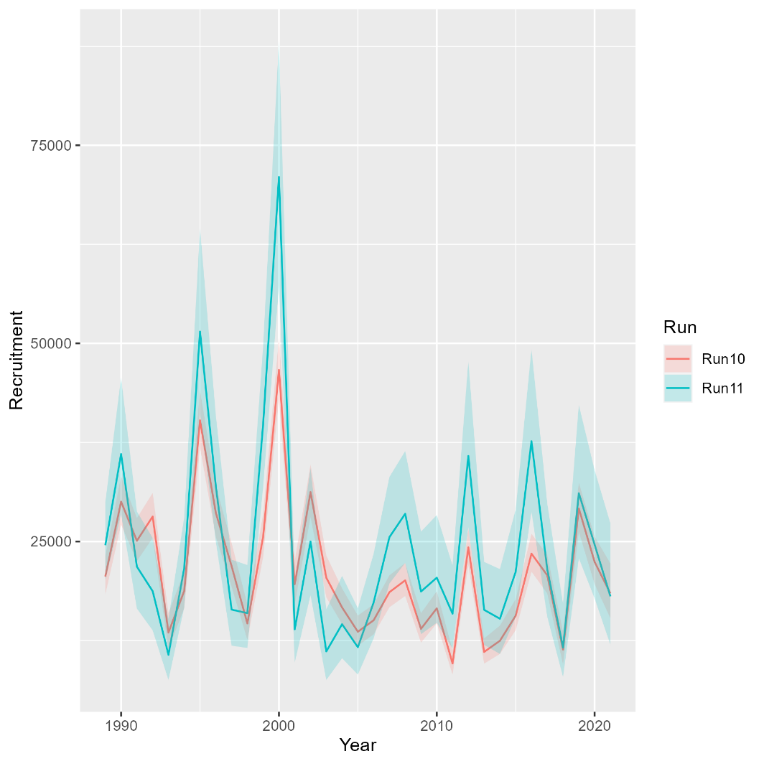
Runs 11: Random effects
Mohn’s rho
Run | F | SSB | Rect
10 | 0.106 | -0.032 | -0.04
11 | -0.005 | -0.017 | -0.006
South

Slide 20
Movement
Run 12: Mixing with movement rate fixed at 0.1
Run 13: Add prior to movement rate at 0.1
Run 14: Switch to logistic normal for age comps
Runs that did not converge:
Run 15: Estimate SD scalar for aggregate Rec CPA
Run 16: Add AR1 on north-to-south movement

Slide 21
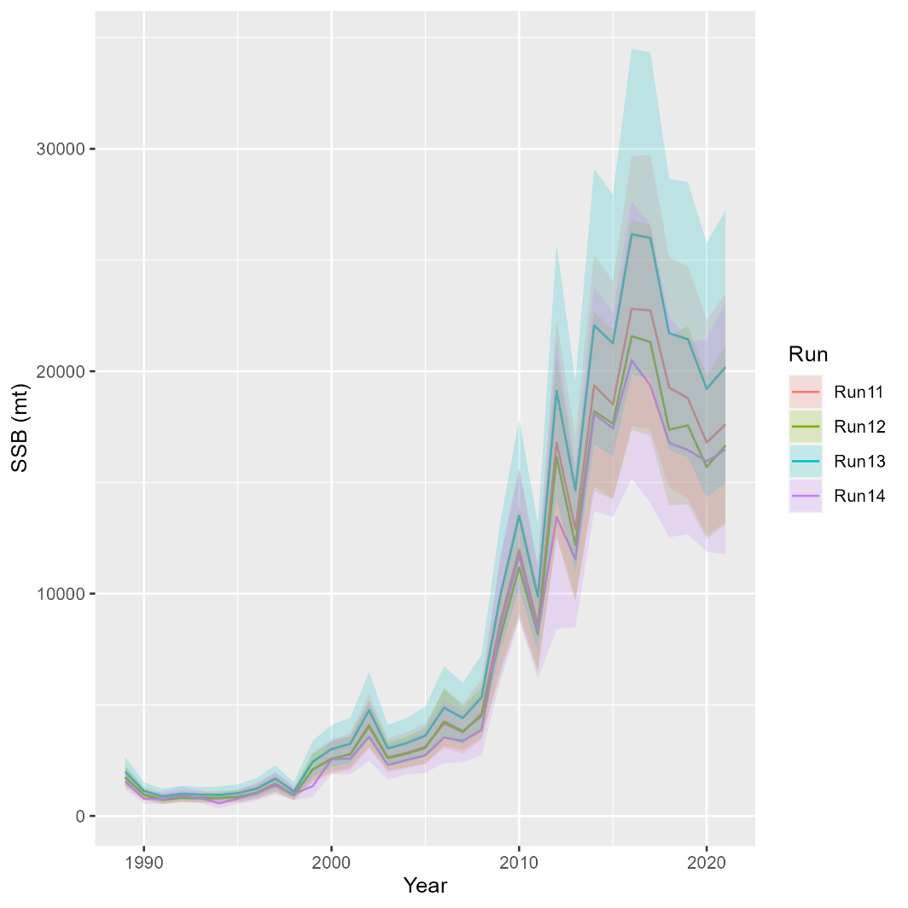
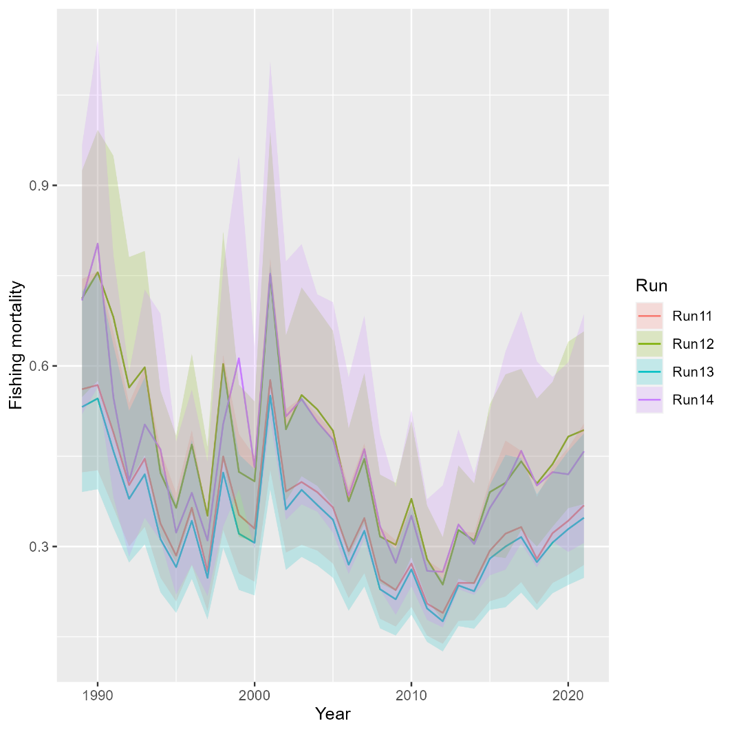
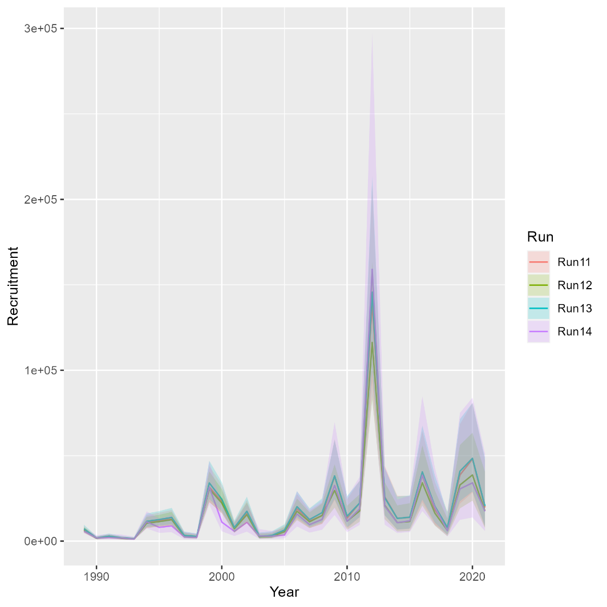
Runs 12-14: Movement
Mohn’s rho
Run | F | SSB | Rect
11 | 0.144 | -0.128 | -0.188
12 | 0.05 | -0.046 | -0.122
13 | 0.172 | -0.151 | -0.205
14 | 0.14 | -0.071 | -0.356
North

Slide 22
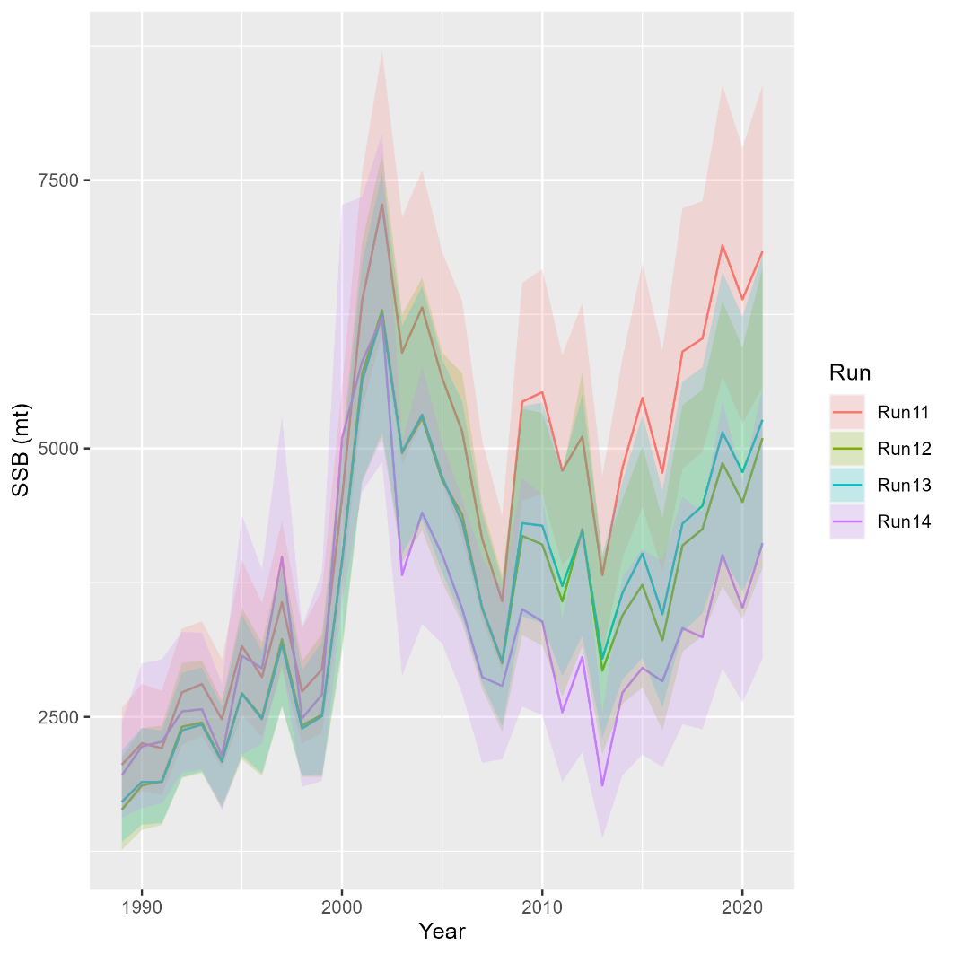
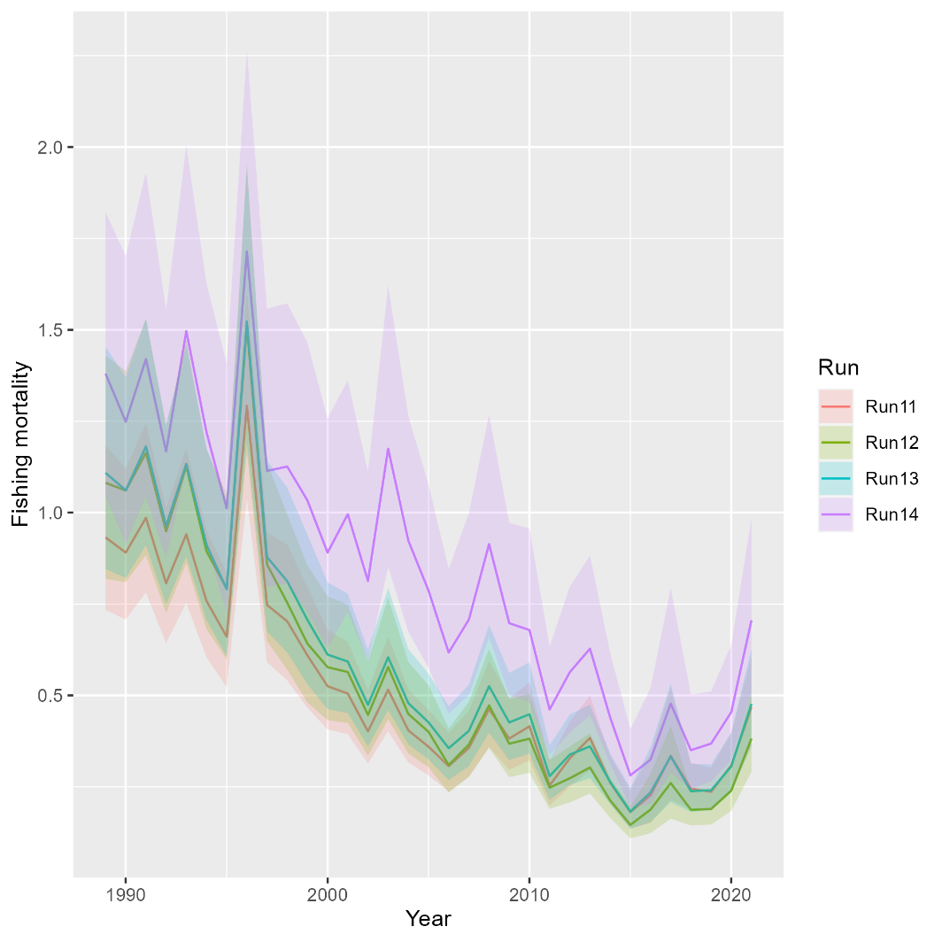
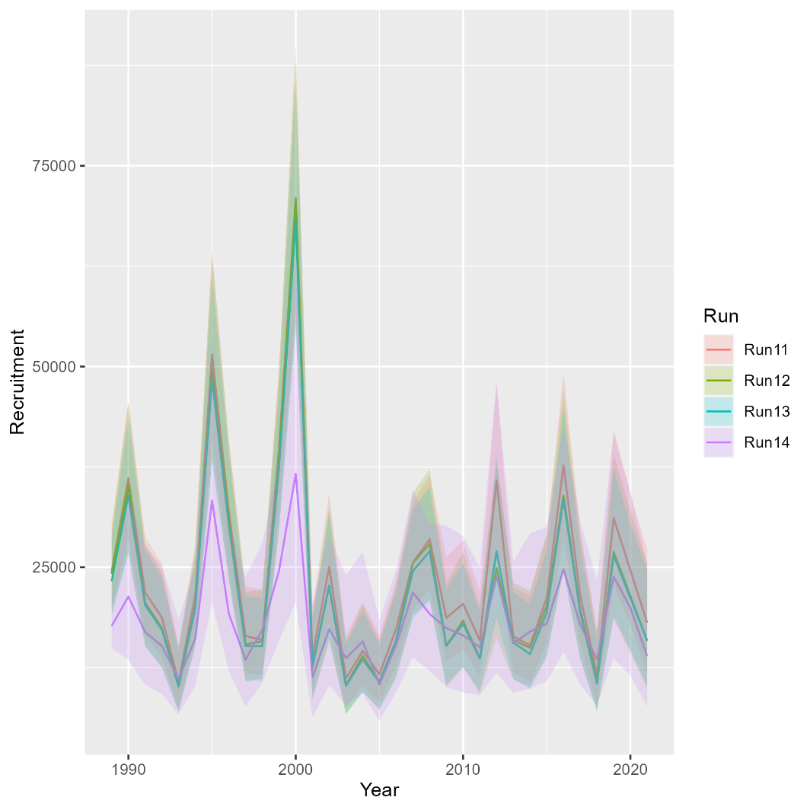
Runs 12-14: Movement
Mohn’s rho
Run | F | SSB | Rect
11 | -0.005 | -0.017 | -0.006
12 | 0.028 | -0.028 | 0.014
13 | -0.031 | 0.07 | 0.018
14 | -0.082 | -0.006 | -0.003
South

Slide 23
On the horizon….
Separate RecCPA selectivity from recreational fishing fleet
….

